Slide 1
PROTECTION AND DETECTION OF AERIAL VEHICLES

Slide 2


Faculty mentor
Team :
Nageshwar kumar (Team Leader)
(2022uee0138@iitjammu.ac.in)
2. Saurav Kumar
(2022uee0150@iitjammu.ac.in)
3. Bhavuk Goyal
(2022uee0126@iitjammu.ac.in)
4. Srija Shukla
(2022uee0151@iitjammu.ac.in)
5. Piyush kumar
(2023uma0227@iitjammu.ac.in)
Dr. Sudhakar Modem.
Electrical Engineering Dept.(Communication Specialization)

Slide 3
CONTENTS
01
02
PROJECT 1
PROJECT 2
Anti-GPS Jamming System
Protection of Aerial Vehicles

Slide 4

1
Anti-GPS Jamming System

Slide 5
OUR ROADMAP
Stage 3
Anti_JAmming tests on leading Drone Models
Stage 2
Integration of GPS Dome with Drones and flight Testing
Stage 1
Integration of GPS Modules and Anti-GPS Jamming Dome

Slide 6
STAGE - 1
Description
Target time : 0 - 1 Month
Remarks :
Integration of the anti-GPS jamming dome into the entire Neo-series receiver module line, enhancing the reliability and performance of GPS tracking and navigation systems.
Anti-GPS Jamming System

Slide 7
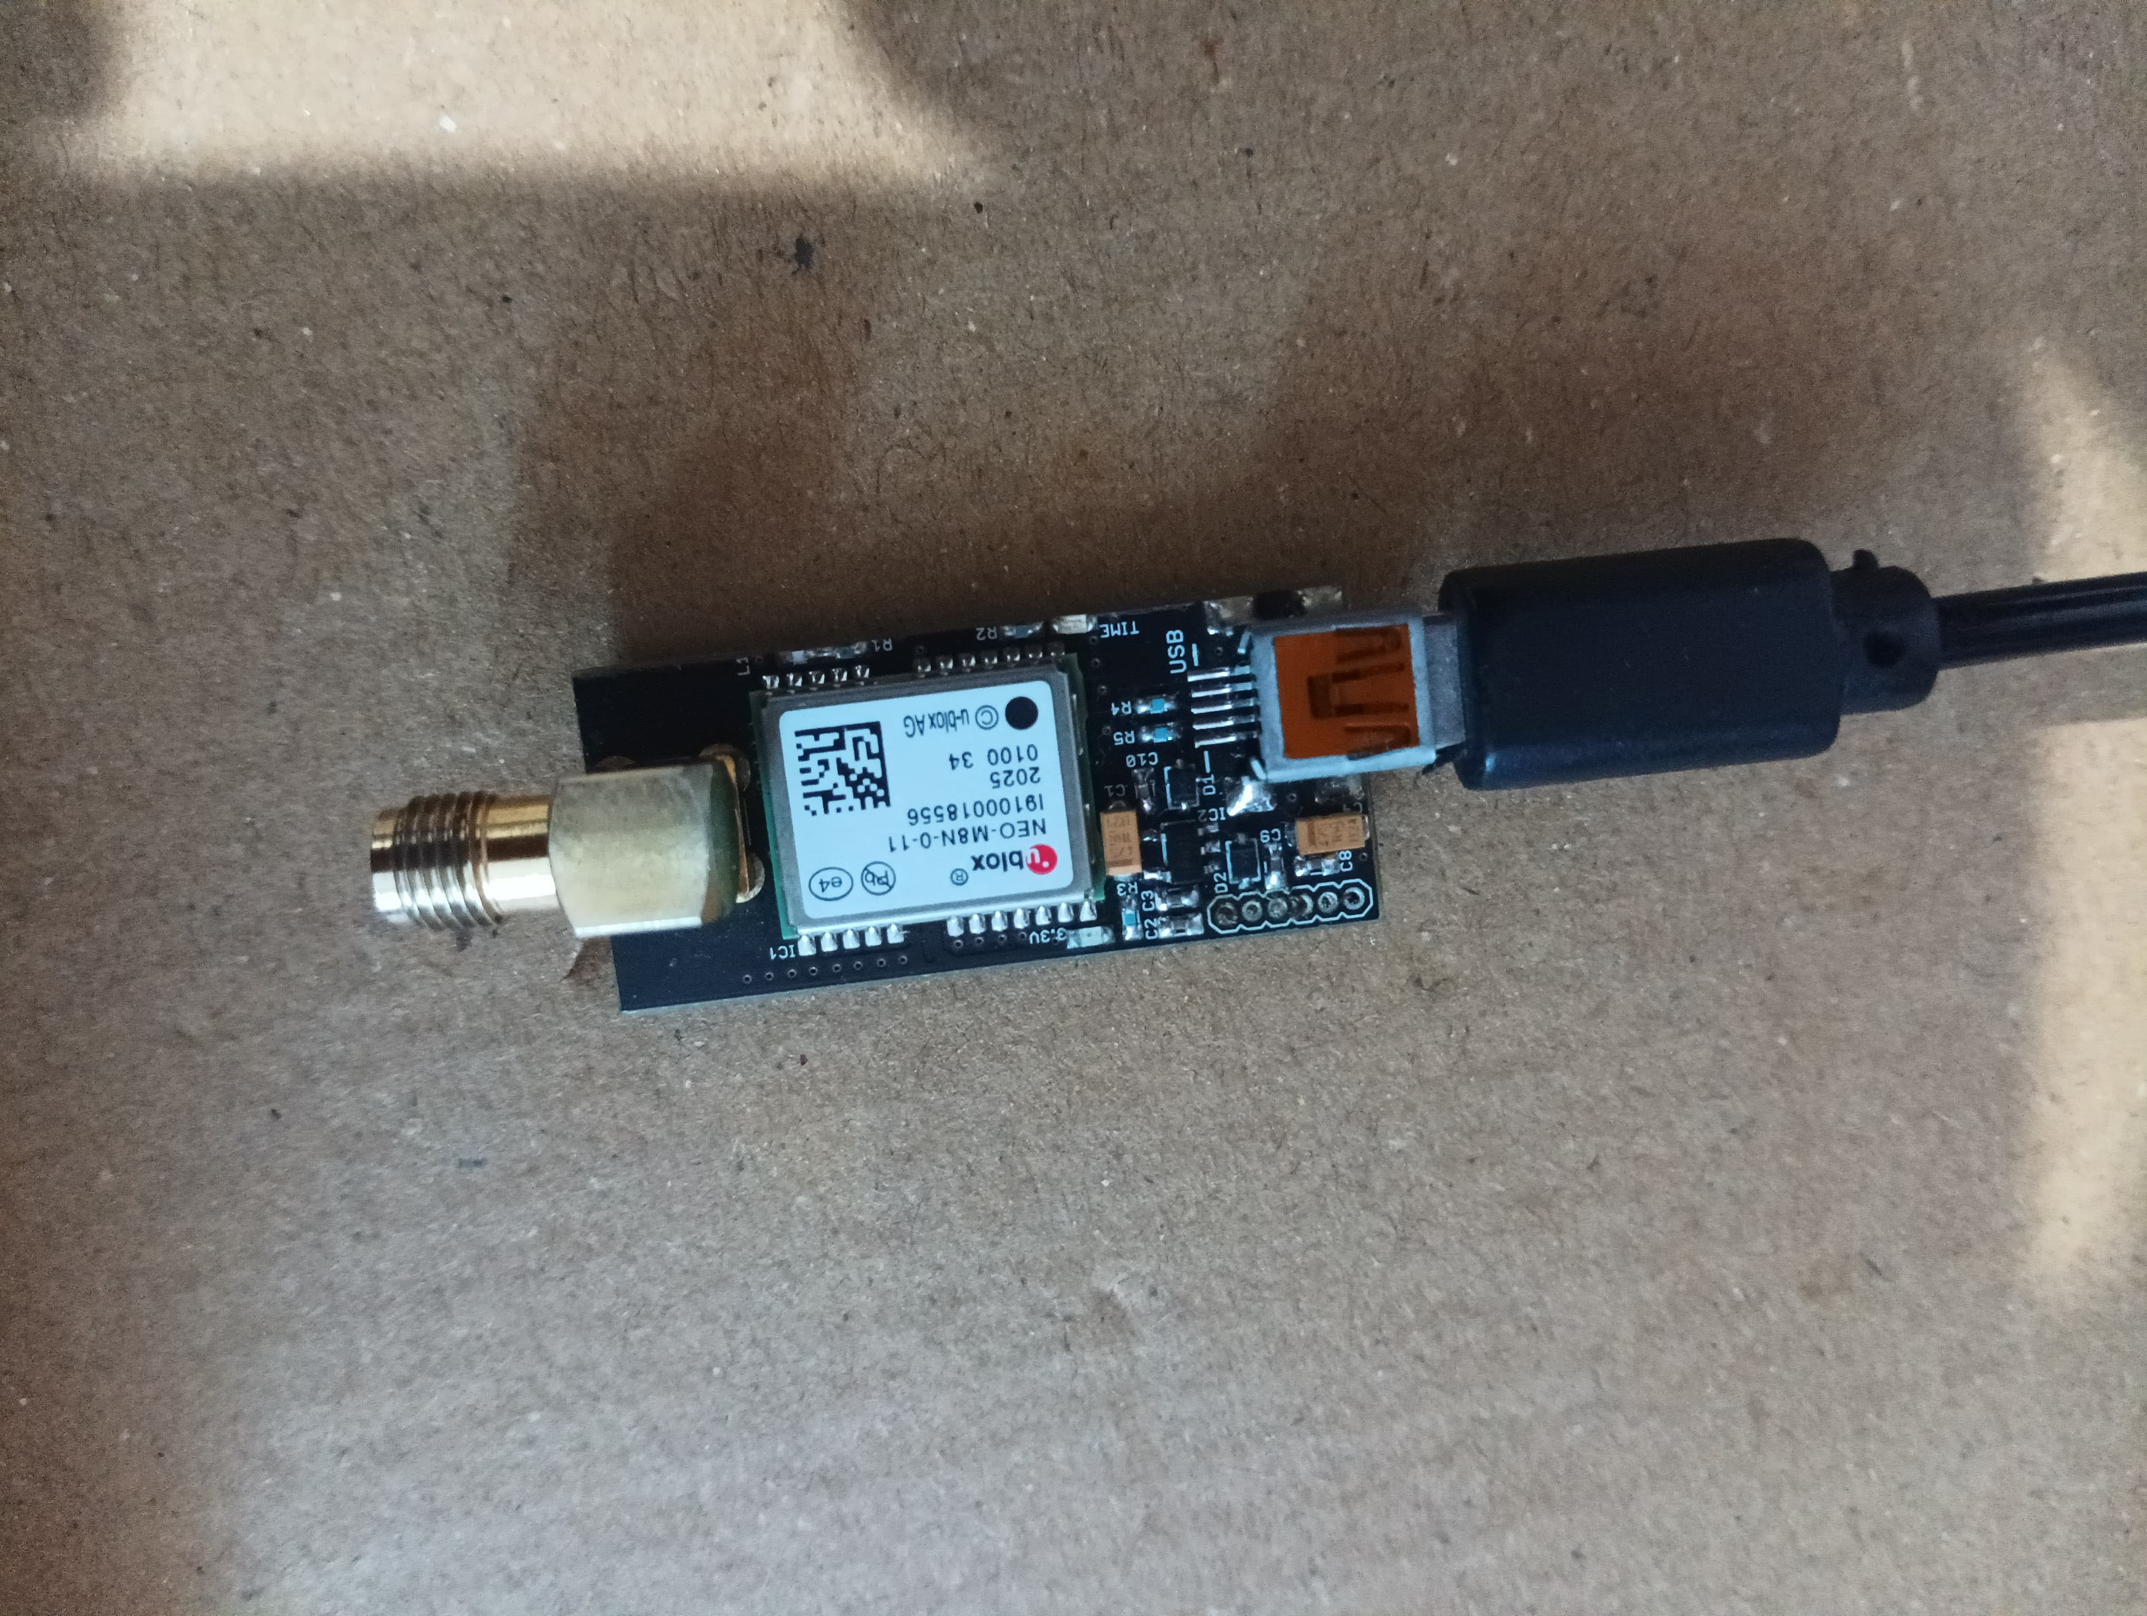
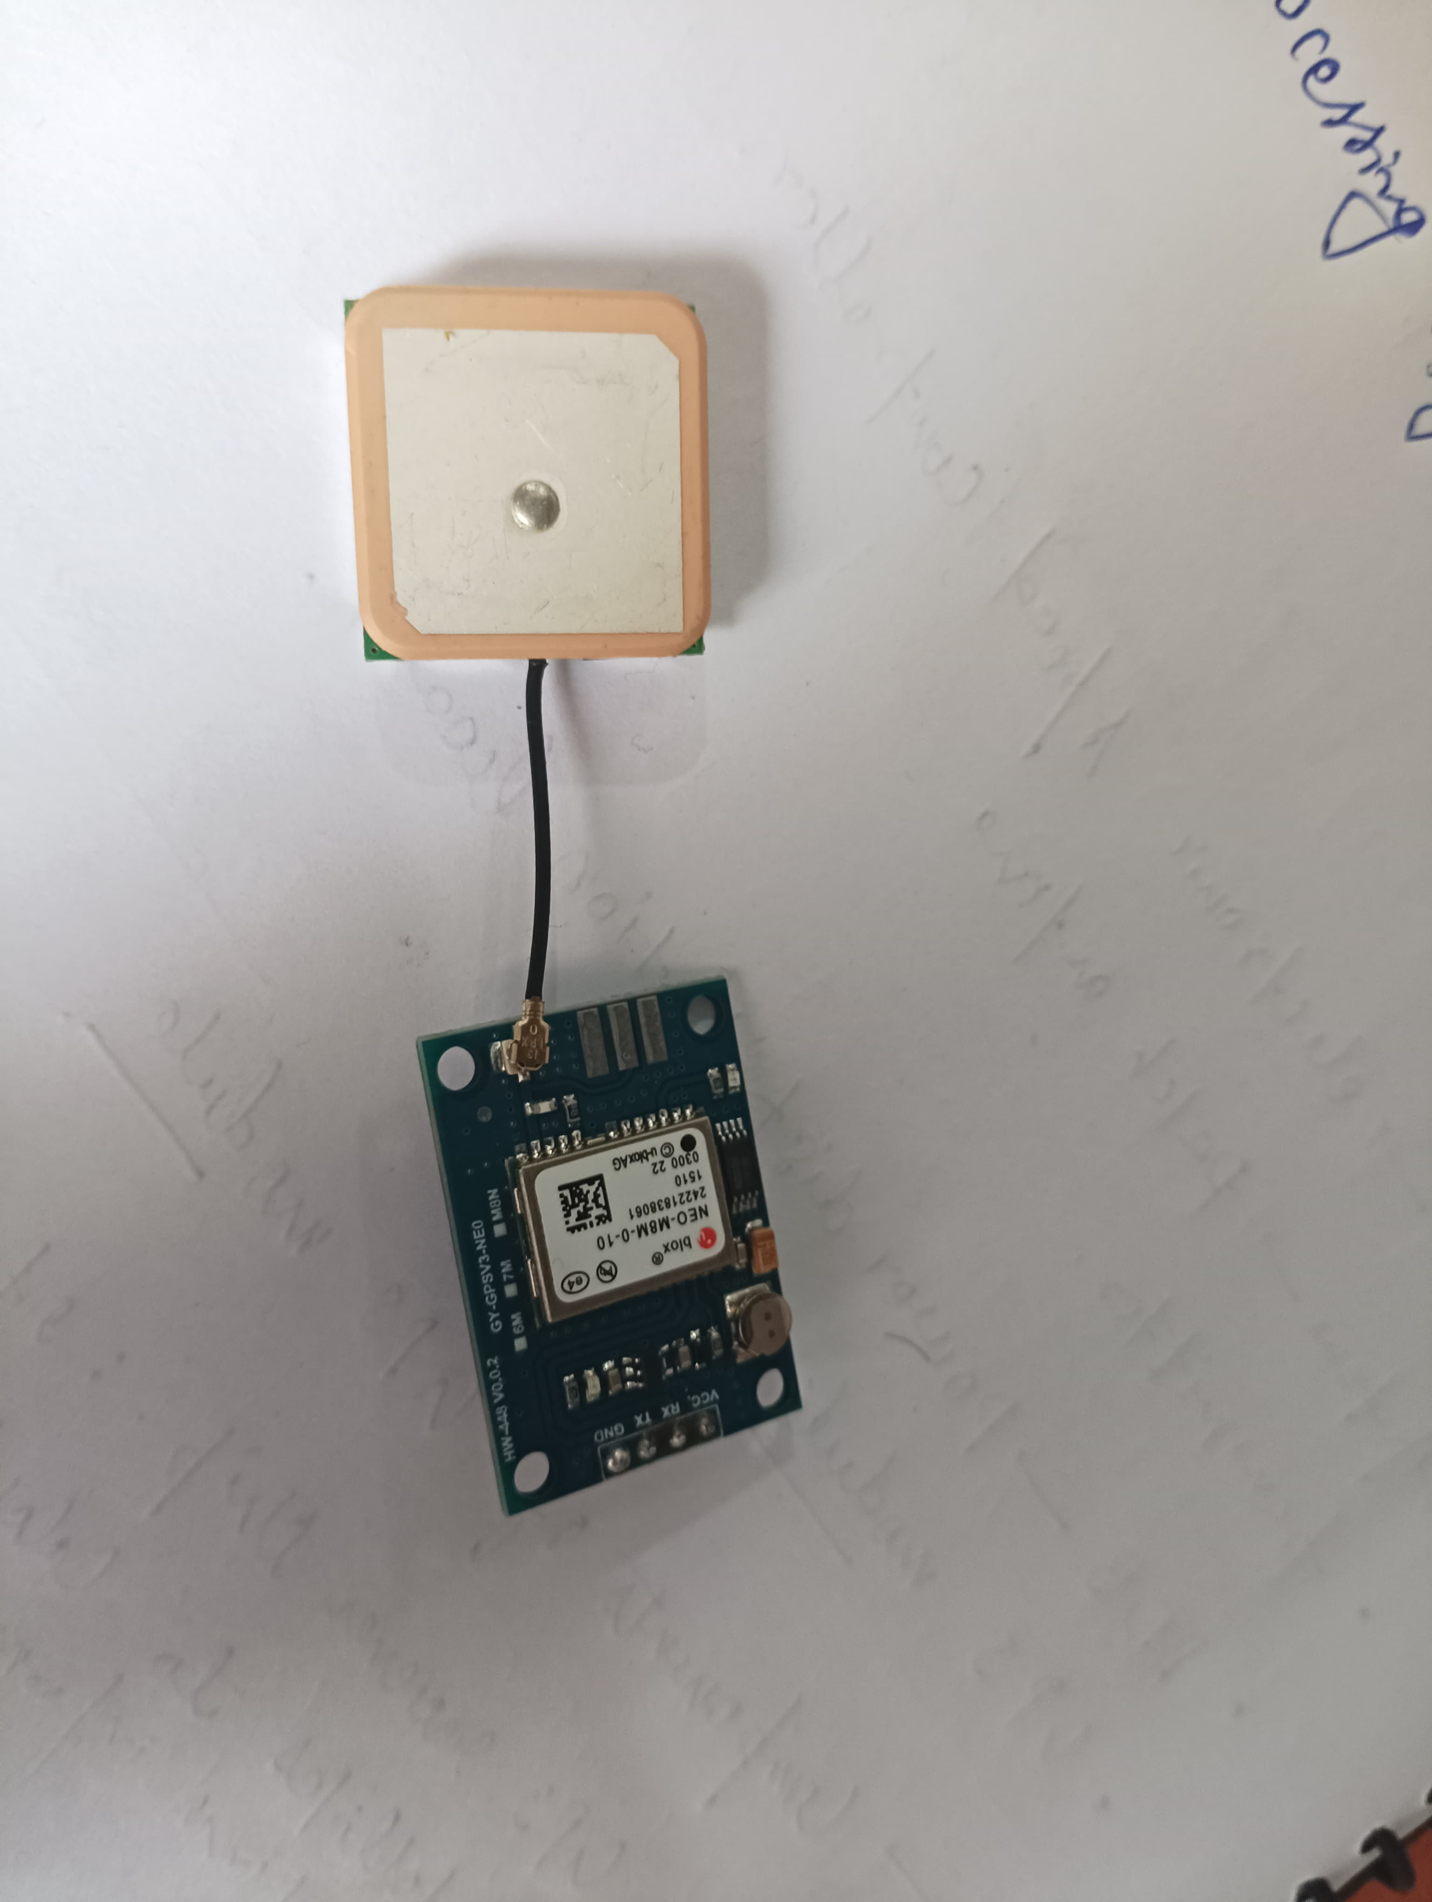
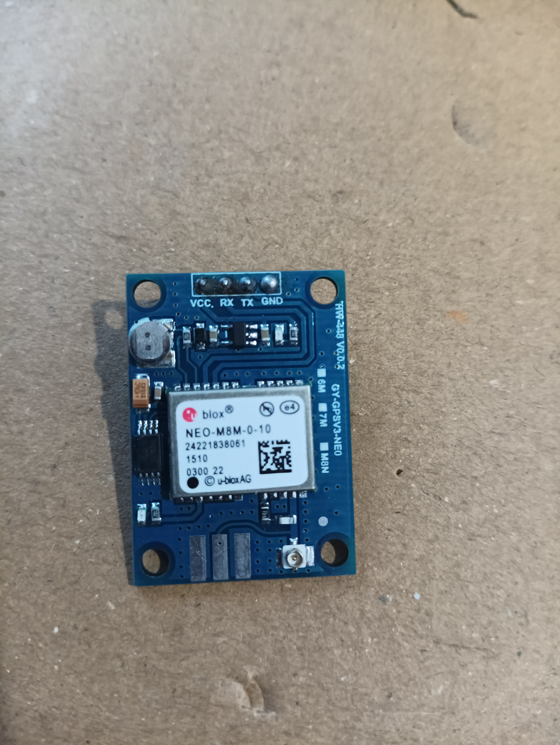
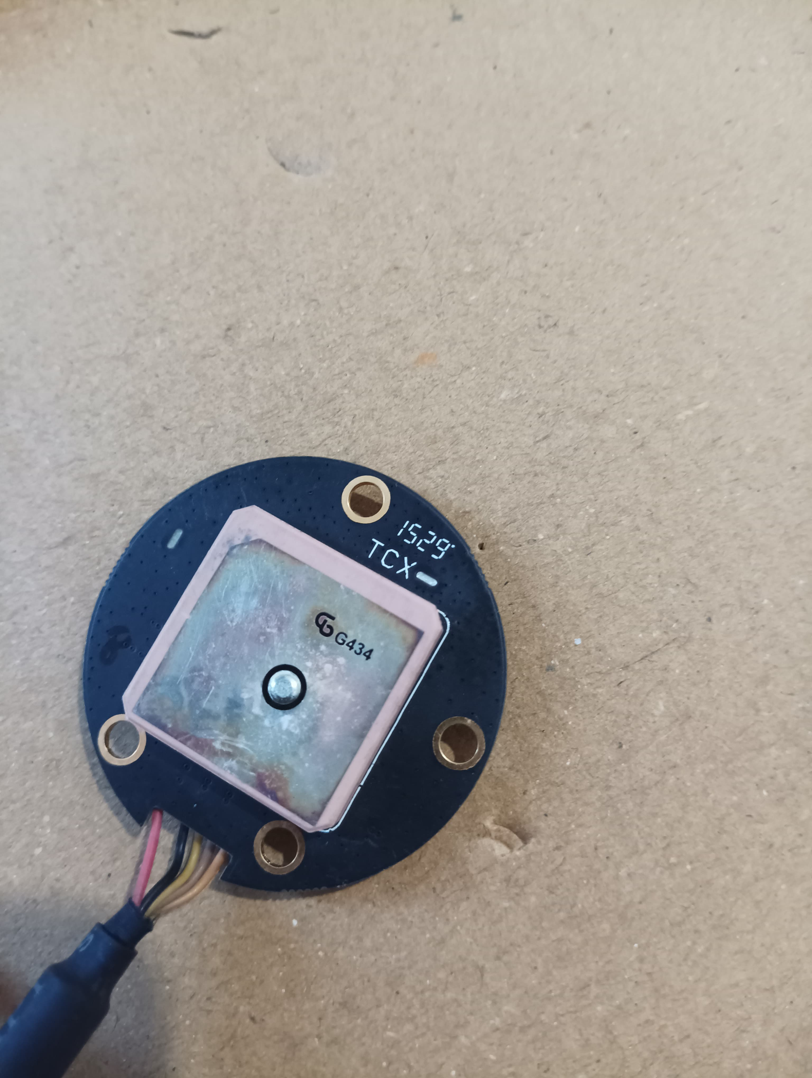
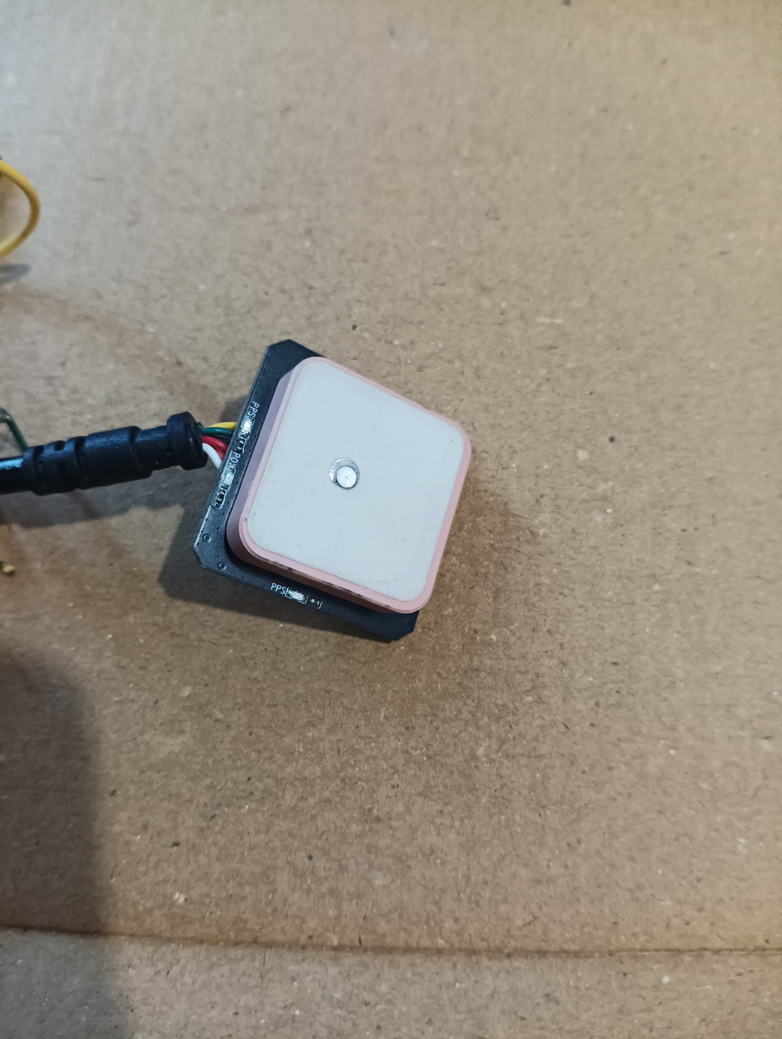
STAGE - 1
Patch Antena
Available Reciever Modules :
Unpatch Antena
NEO-M8N-0-11
NEO-M8M-0-10
Phantom GPS module
GPS Module
Anti-GPS Jamming System

Slide 8
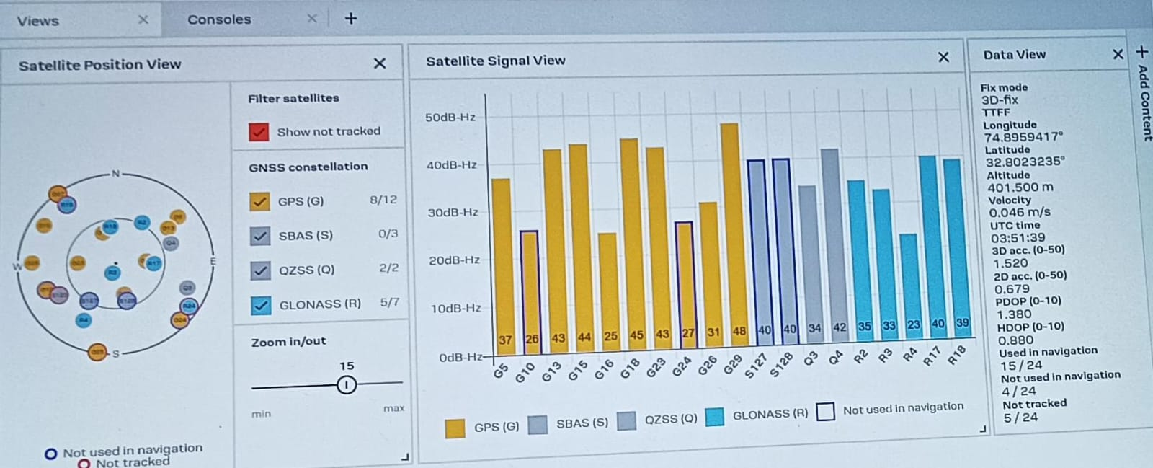
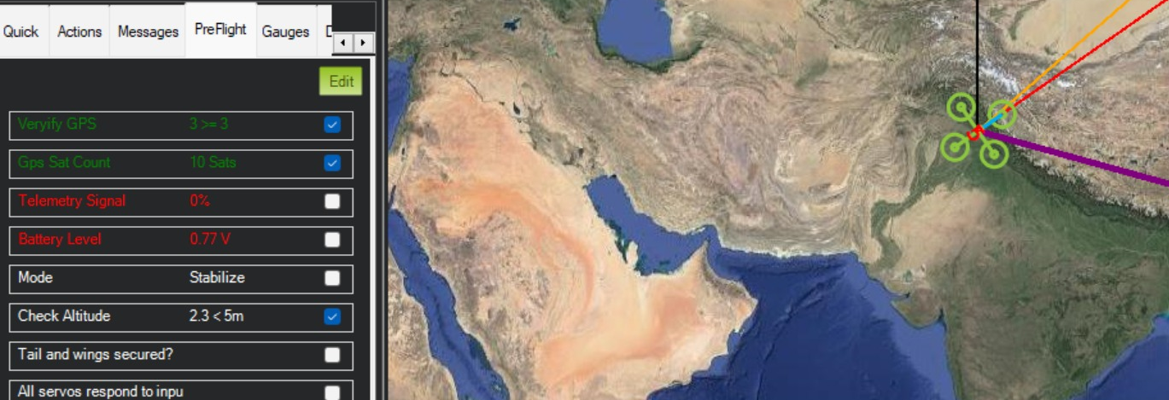
blob:https://web.whatsapp.com/852c6c1d-4e10-412c-bc8d-0db5b5e7c521
STAGE - 1
Progress of Project :
Successfully Integrated Neo-M8N reciever Module with pikshawk and anti-GPS jamming dome
Integrated Neo-M8M reciever Module with pikshawk and anti-GPS jamming dome and verified its satellite count from Mission Planner
To Do :
testing of the behavior of Neo-M8M reciever Module when it will be integrated with GPS Dome (delay due to complete discharge of Battery)
Extra inputs in this stage : we are trying to convert UART mode of communication to USB mode of communication for easy demonstration of our project.
fig : satelite strength and Data view of Neo-M8N reciever Module
fig : satelite Count of Neo-M8M reciever Module
Anti-GPS Jamming System

Slide 9
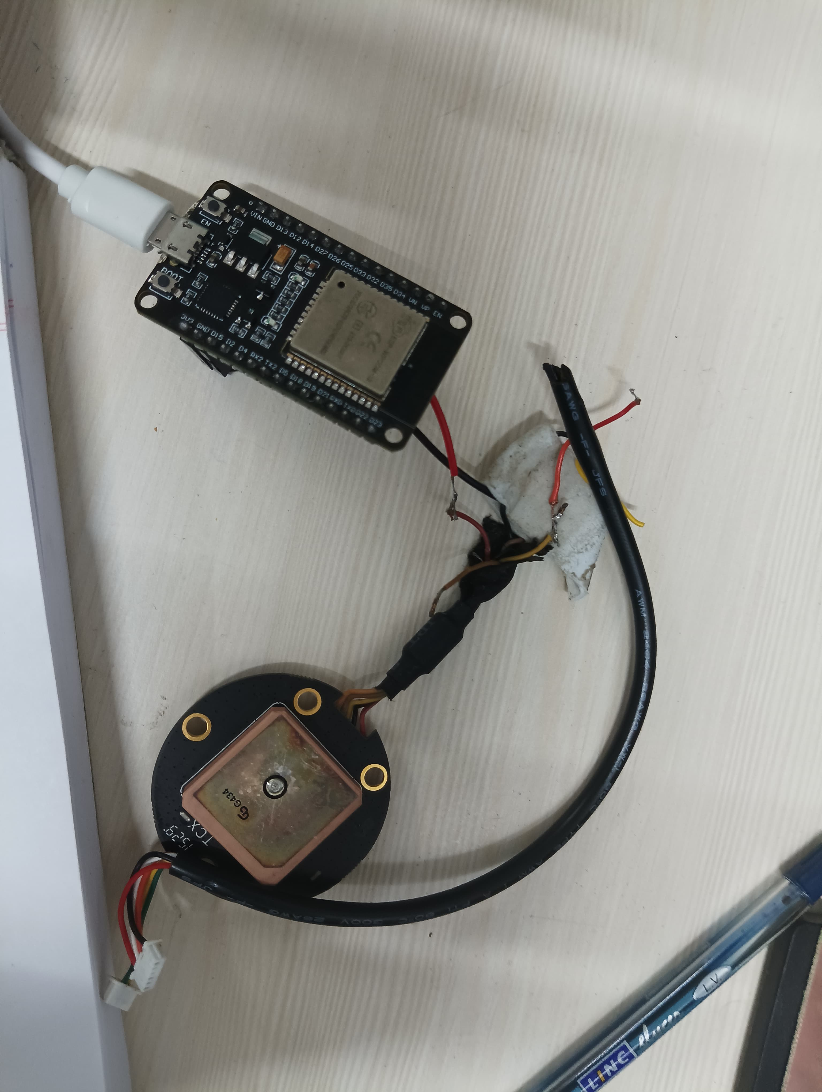
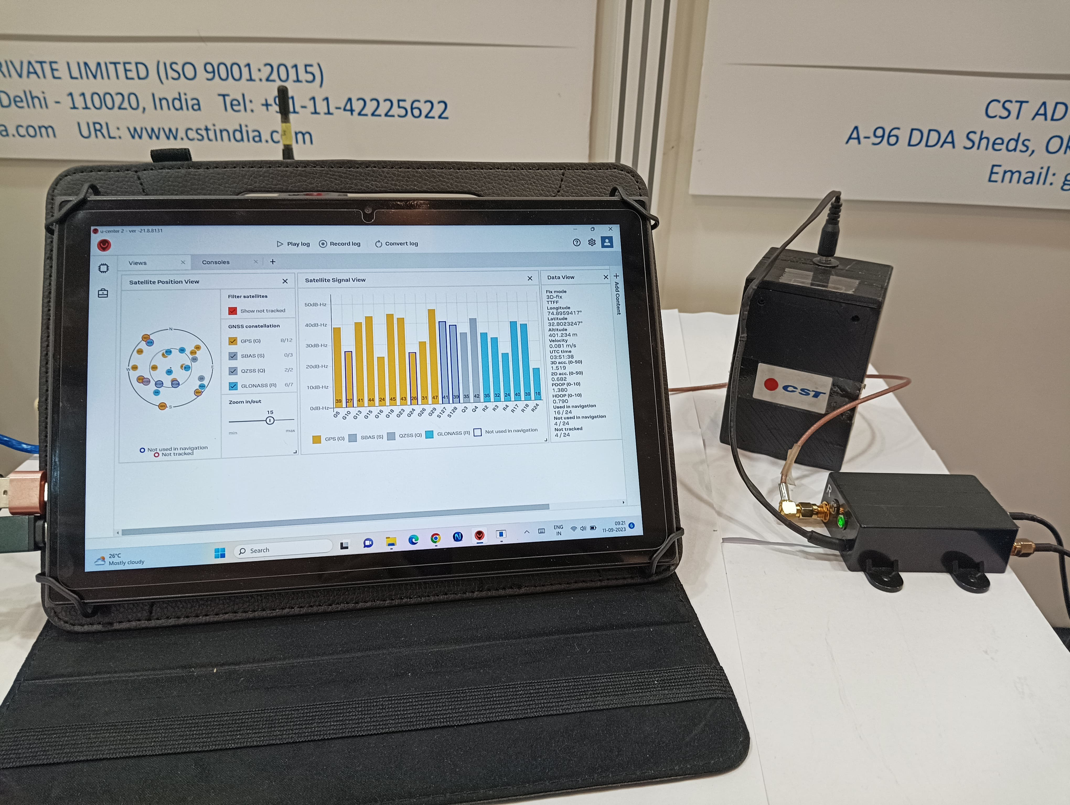
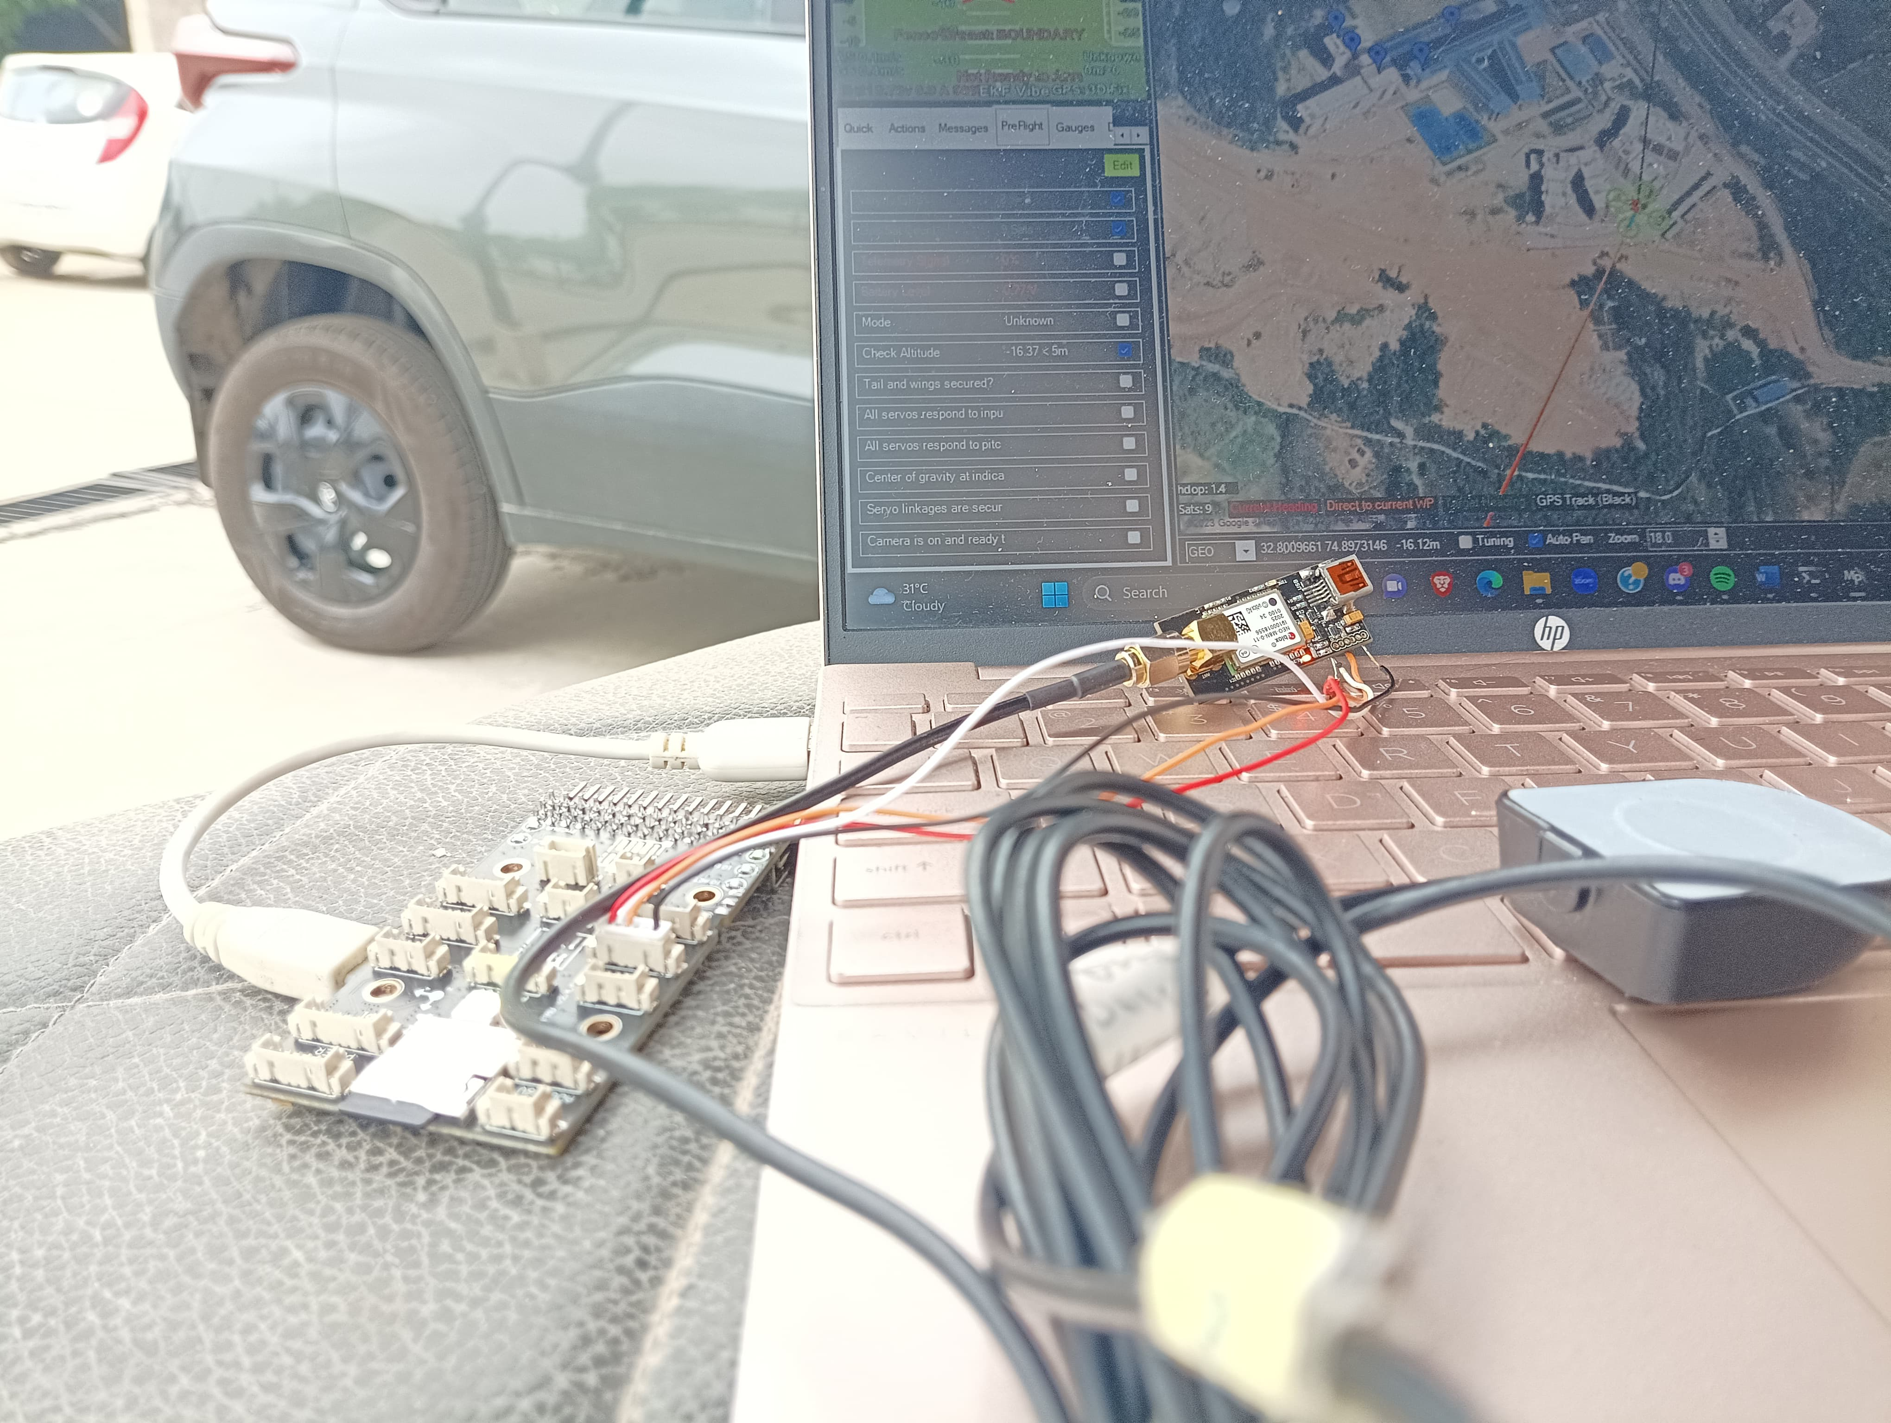
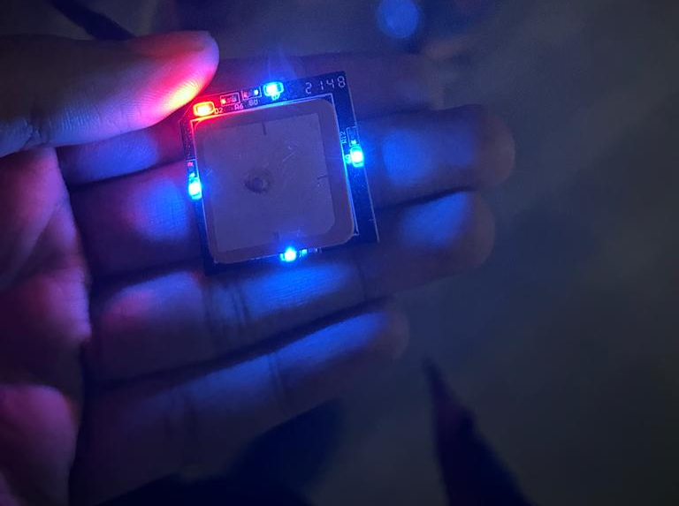
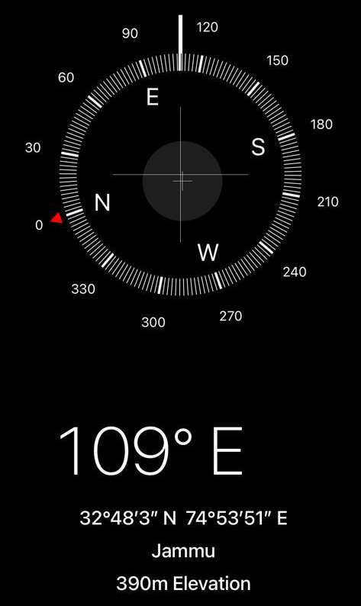
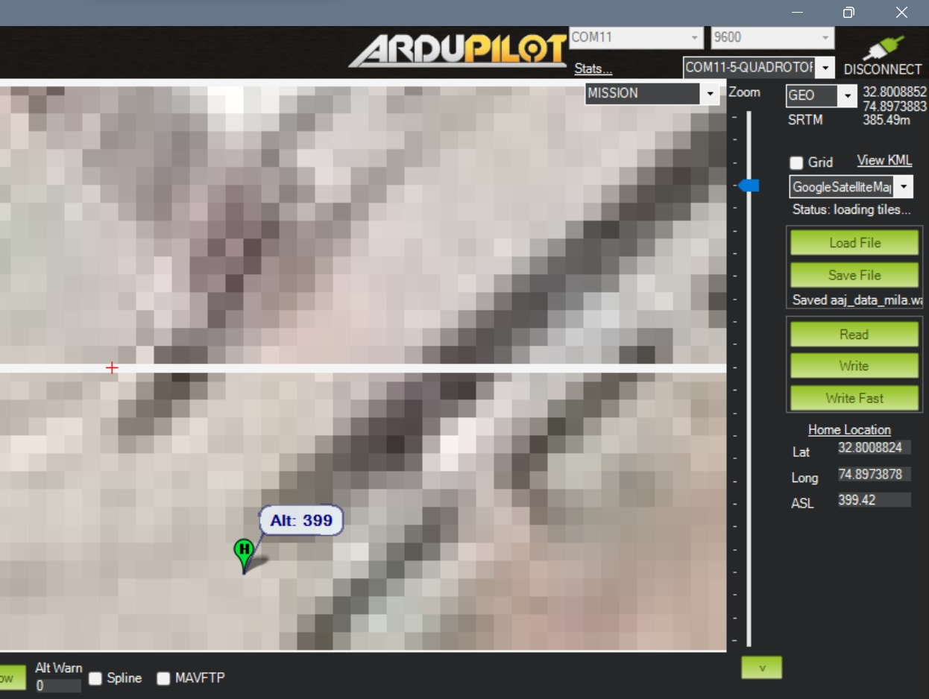
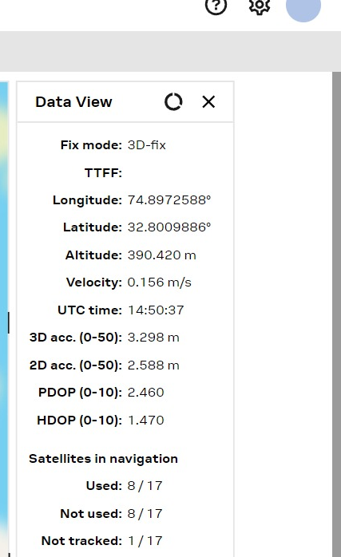
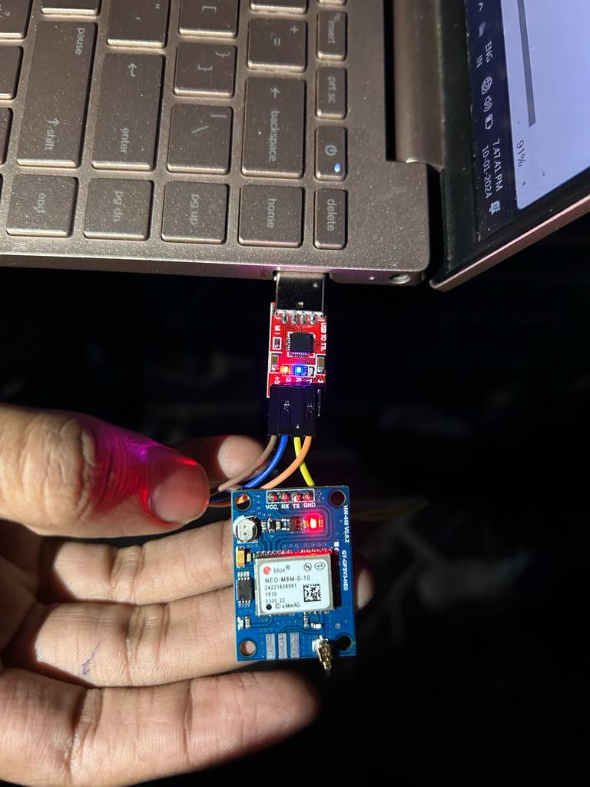
STAGE - 1
Project Gallery :
Demonstration in North-Tech Symposium
Successful integration of NEO-series reciever Modules with pikshawk
successful integration of Phantom GPS module with Pikshawk
fully functional Neo-M8M GPS module
verifying Data of Latitude, longitude and Altitude of Mission planner without using any Jammer
UART to USB communication to fit any GPS module to any type of Vehicle
Anti-GPS Jamming System

Slide 10
STAGE - 2
Description
Target time : 1 - 2 Month
Remarks :
Integration of GPS domes with in-house lab drones, paving the way for forthcoming testing on drones from renowned industry players
Anti-GPS Jamming System

Slide 11
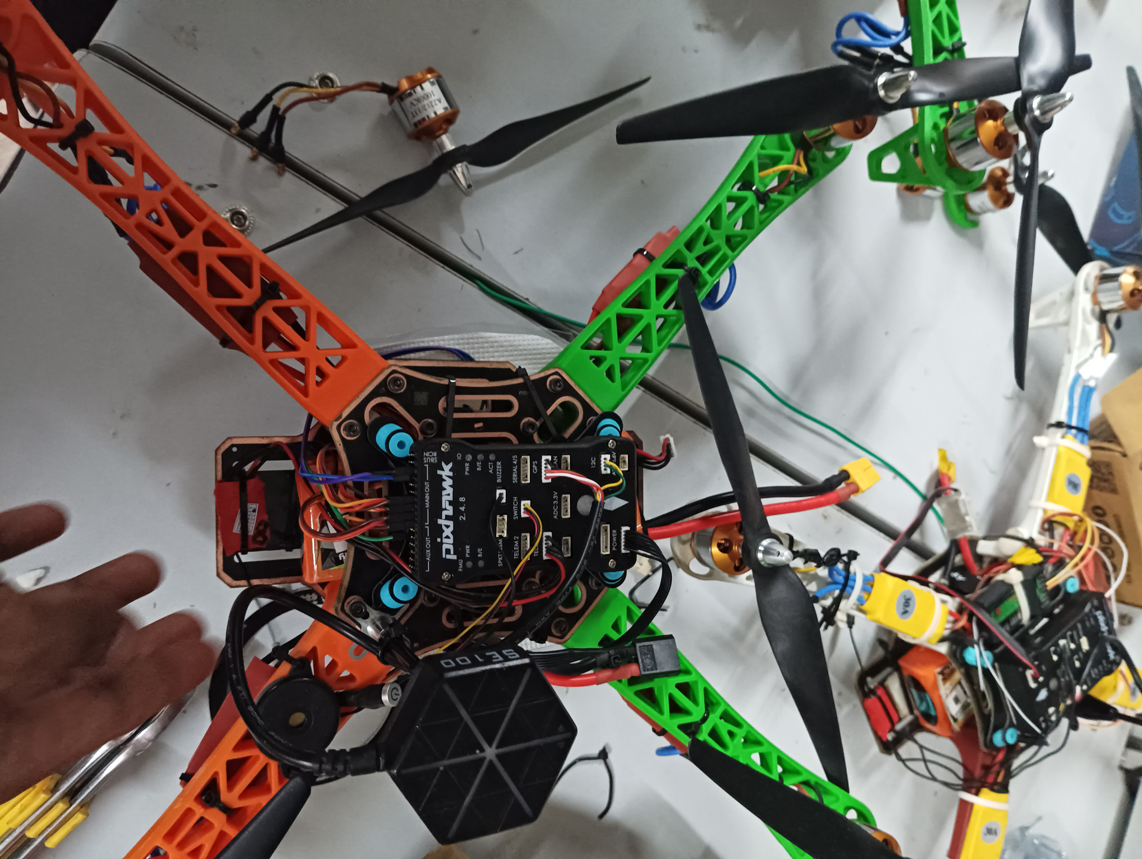
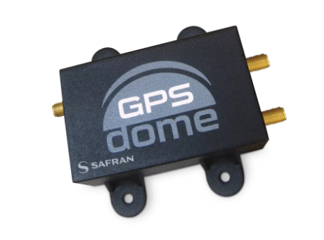
STAGE - 2
Progress of Project :
we are now ready for testing with in-house lab Drones only we have to verify the working and response of Anti-GPS jamming Dome.
what we will do before testing ?
We will collect a minimum of 100 sets of latitude, longitude, and altitude data at one-second intervals. Subsequently, we will calculate the relative error of the GPS receiver based on this data. Following that, we will perform the same procedure with the Dome to get its relative error..
if the relative error will be <5% then will proceed with testing .
Requirements :
one in-house lab Drones
fig : Anti-GPS Jamming Dome
fig : In-House lab Drones
Anti-GPS Jamming System

Slide 12
STAGE - 3
Description
Target time : 3 - 4 Month
Remarks :
Flight tests and robust anti-jamming assessments on DJI and other leading drone models post-dome integration, with ongoing efforts to ensure seamless dome adaptability across a range of renowned drone platforms.
Anti-GPS Jamming System

Slide 13

2
Protection of Aerial Vehicles

Slide 14
THANK YOU

